Slide 1

SOCKET PROGRAMMING PROJECT
Apostol Rares-Andrei
Staicu Dan Dominic

Slide 2
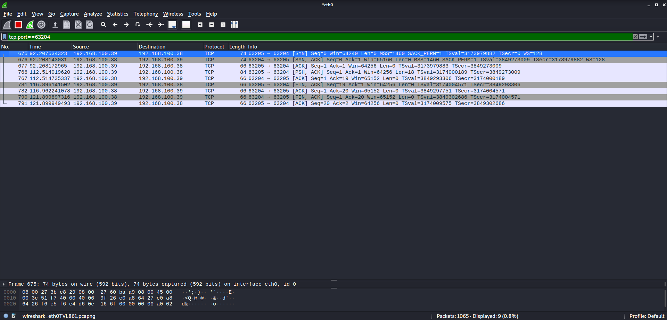
TCP
Wireshark capture for TCP implementation. Packet 766 contains the message sent.

Slide 3
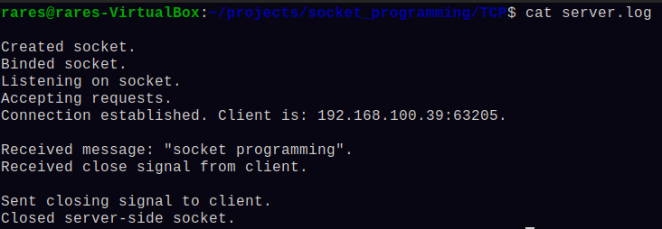
This is what the log file contains for the previous capture.

Slide 4
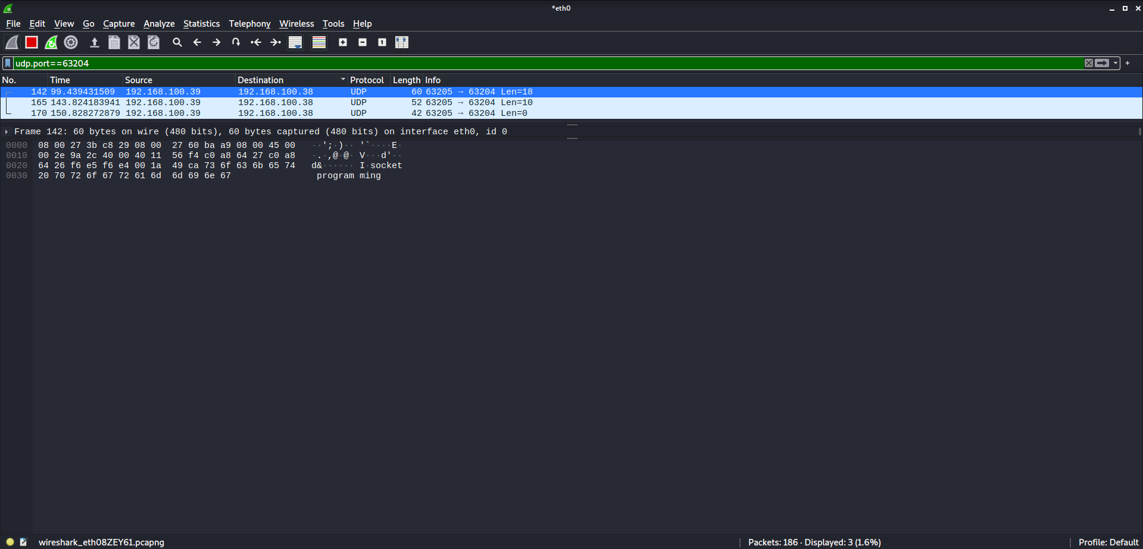
UDP
Wireshark capture for UDP implementation. Packet 142 and 165 contain messages sent by the client, and packet 170 signals the end of the transmission, so both client and server can close the sockets.

Slide 5
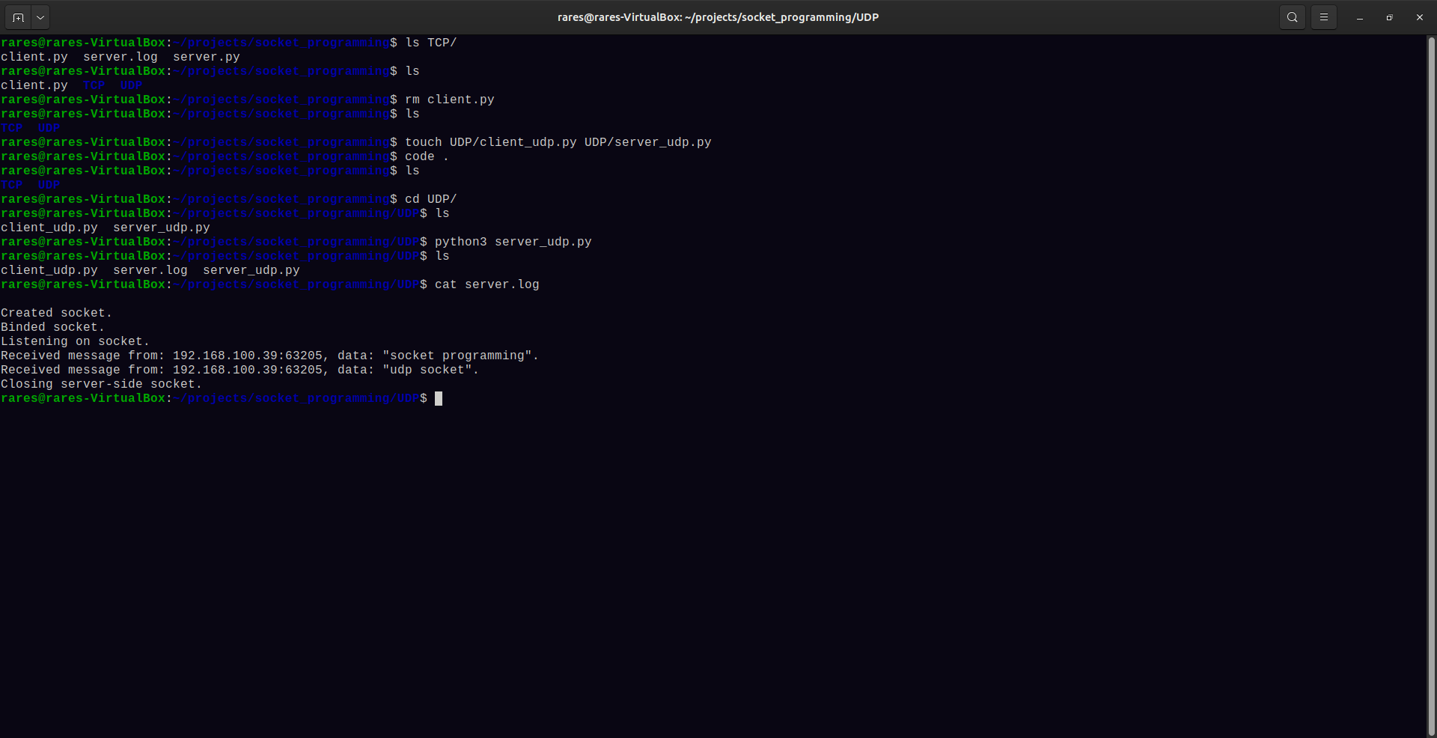
This is what the log file contains for the previous capture.

